Slide 1
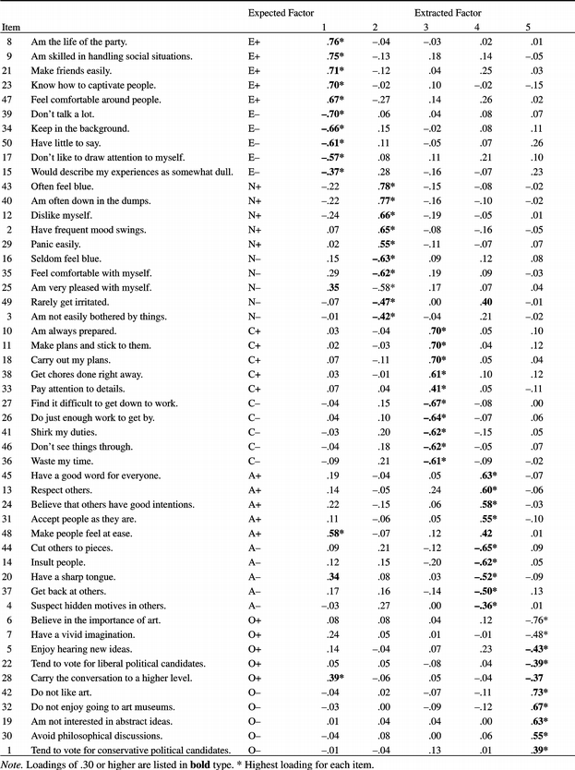
Factor loadings of all 50 items on each of the five varimax-rotated components
Buchanan, T., Johnson, J. A., & Goldberg, L. R. (2005). Implementing a Five-Factor Personality Inventory for Use on the Internet. European Journal of Psychological Assessment, 21(2), 115-127. doi:10.1027/1015-5759.21.2.115
© 2005 Hogrefe & Huber Publishers

